Slide 1
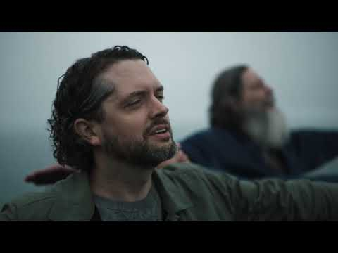
Subaru commercial | See the World
Notes:
Good afternoon everyone,We are here to present you our idea for the event FallFEST i.e. we are here to tell you about our app Sammy.
First of all, a question arrises in everyone’s mind that What exactly is Sammy.Sammy is a video player built for accessibility.
It is specially created for visually impaired people and is somewhat helpful for the normal people as well.
Let’s have a look at this video illustration first. You may close your eyes to feel what exactly a visually impaired person would feel.
<--video played-->
You might have noticed that a certain different voice popped up in between scenes to explain you what was going on at that particular moment.
That voice is called audio description.
Precisely, audio description is one of the things that Sammy does.

Slide 2
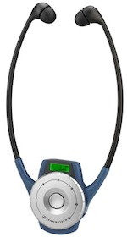
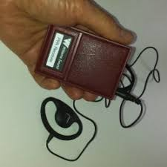
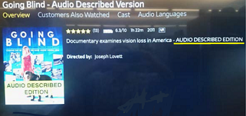
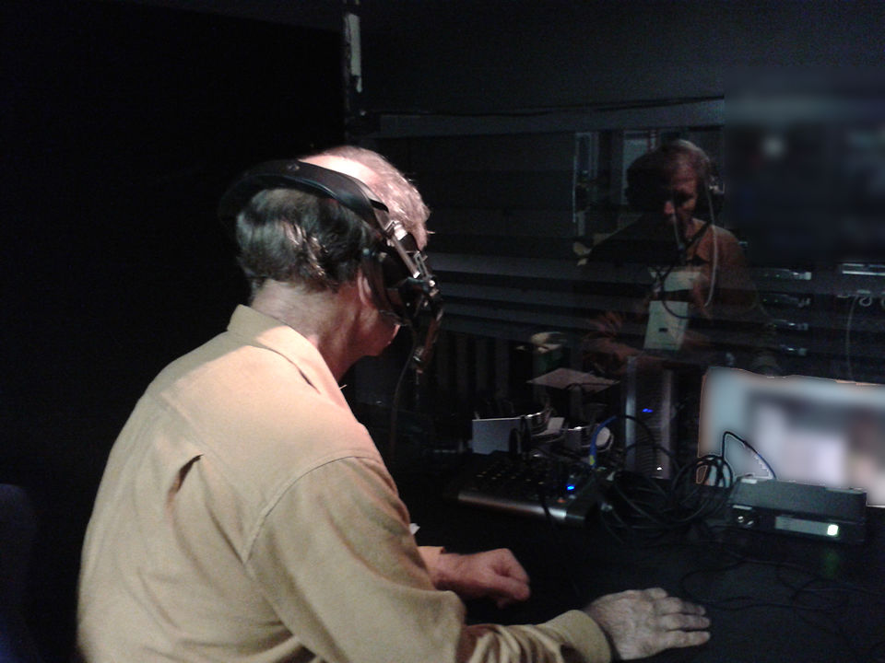
Audio Explaining Devices
PRESENT
DSV recording in a theatre
Specially Created Audio Described Version of Going Blind
Notes:
In the cinematic world, audio description for the visually impaired is a very tedious process involving scripting, recording and rendering audio.It requires special equipment which has to be provided to specific disabled audience.
This requires a lot of human effort and is actually very expensive.
Making every video audiodescriped individually is not a feasible task and hence, Sammy would be the best alternative.
Let’s jump to the second task performed by sammy.This feature would not just be beneficial for the visually impaired but will also help the normal people.
When as a user you need to find content inside a video, say a simple line, you have to go through the whole video.but Sammy would help you to jump directly to that particular part.
Now, my teammates would make you familiar with the aspects and technicality of the problem and solution in detail.

Slide 3


Sammy - A video player built for accessibility
TEAM SAMMY, IIT (ISM) DHANBAD
Notes:
These problems form the base case for our idea and this presentation.

Slide 4
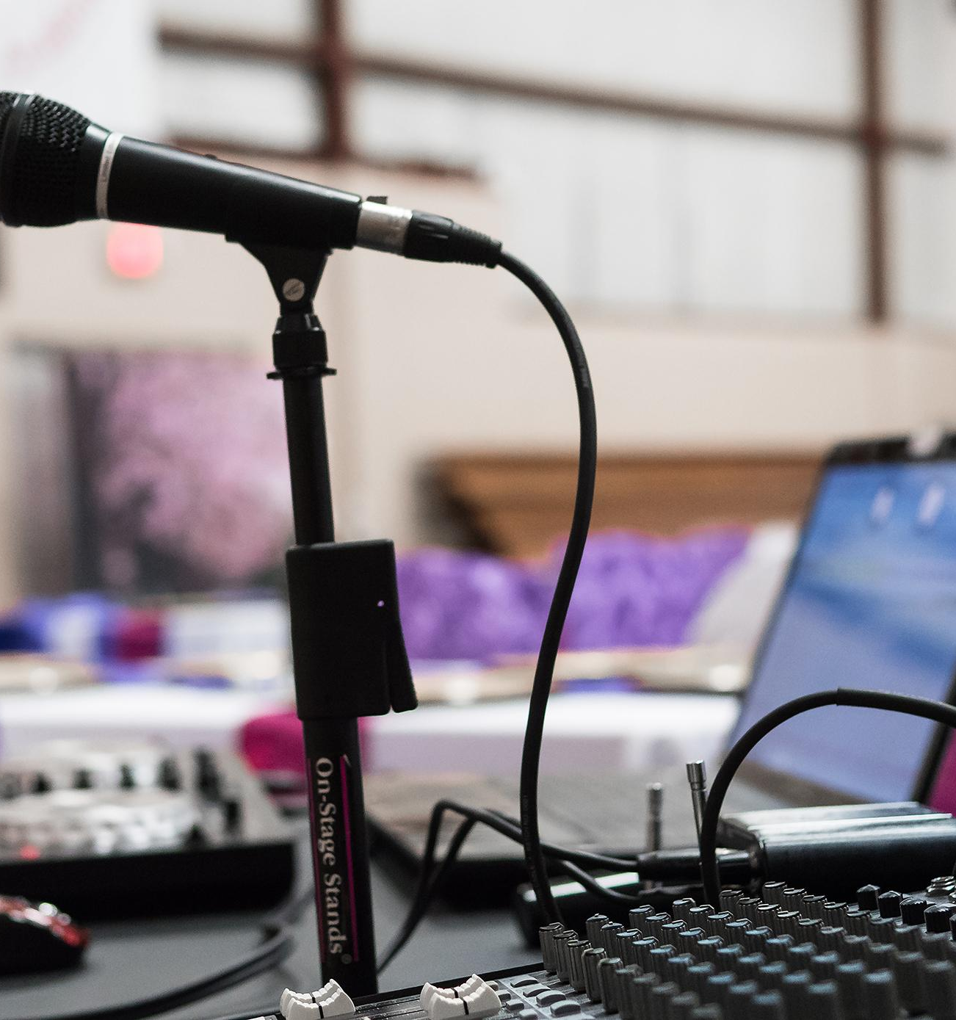
THE PROBLEM
Notes:
Let’s define the problem once. The problem is...

Slide 5

THE PROBLEM
Is simple
Notes:
Simple.

Slide 6
THE PROBLEM
For the visually disabled to navigate and understand a video, it must be audio described.
For the video to be searchable, we need to search throughout the video.
Notes:
If you a visual-disability, you need audio descriptions to watch a video. To make these audio descriptions, you need resources -- money, time and effort.
A regular person like us can hardly have any of these facilities.
As a regular person, to find a particular topic inside the video you need to search throught the video and to do that you’ll have to go through the whole video, it’s tough and a time tedious job!

Slide 7

THE SOLUTION
Notes:
Our proposal as a solution to this problem is...

Slide 8
THE SOLUTION
Is simpler
Notes:
Even simpler.
Where we create descriptions manually, with so much time and effort restricting access against the vast majority of our visually disabled population which is not able to afford video entertainment or information, why can’t we make this happen for free with the help of Machine Learning techniques.

Slide 9
THE SOLUTION
Let video players do the job of understanding the video; and then have them explain it to you in concise terms
Notes:
Into the picture, comes Sammy. A video player that can do all of this automatically.
This player will generate descriptions, create an index of terms inside the video and explain it to the user where it is required.
And that’s exactly what we built Sammy to do.

Slide 10
Subaru commercial | See the World
Notes:
This is the video we played initially.
Good afternoon everyone,We are here to present you our idea for the event FallFEST i.e. we are here to tell you about our app Sammy.
First of all, a question arrises in everyone’s mind that What exactly is Sammy.Sammy is a video player built for accessibility.
It is specially created for visually impaired people and is somewhat helpful for the normal people as well.
Let’s have a look at this video illustration first. You may close your eyes to feel what exactly a visually impaired person would feel.
<--video played-->
You might have noticed that a certain different voice popped up in between scenes to explain you what was going on at that particular moment.
That voice is called audio description.
Precisely, audio description is one of the things that Sammy does.

Slide 11
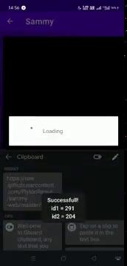
Video Demo

Slide 12



Slide 14
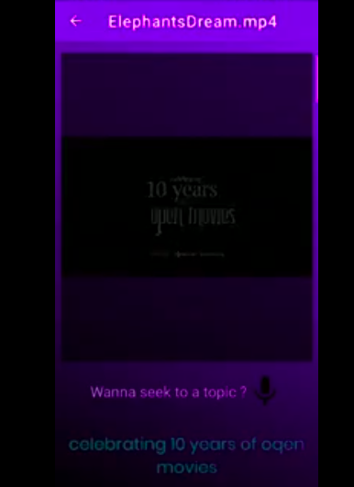
OCR
Recognised Text
￼
Recognises text from the screen and sends it to audio output

Slide 15
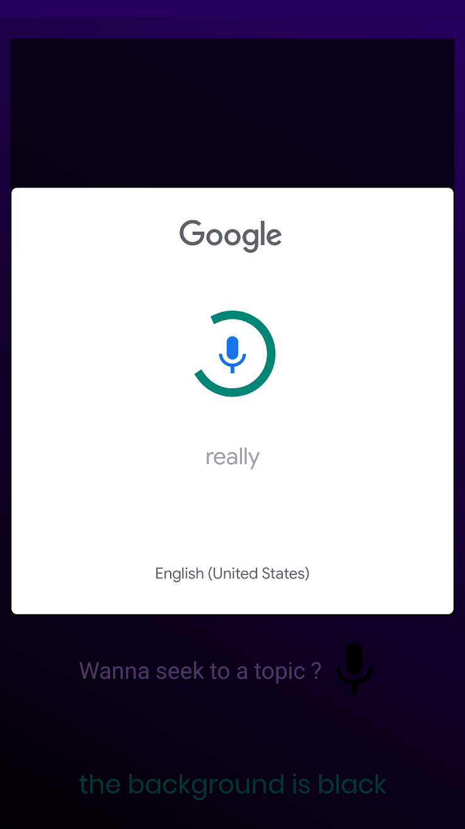
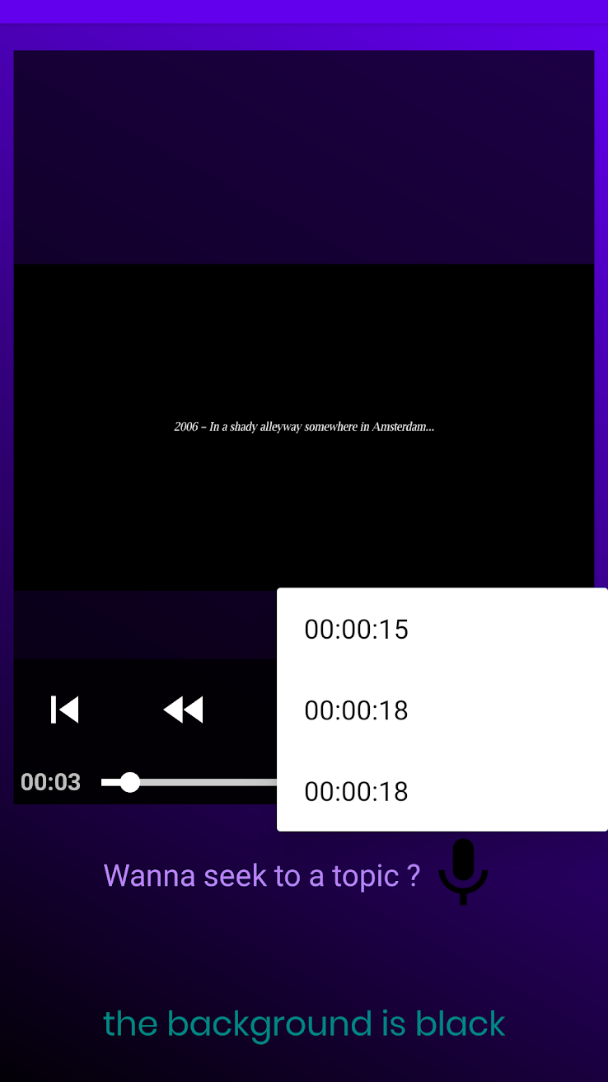
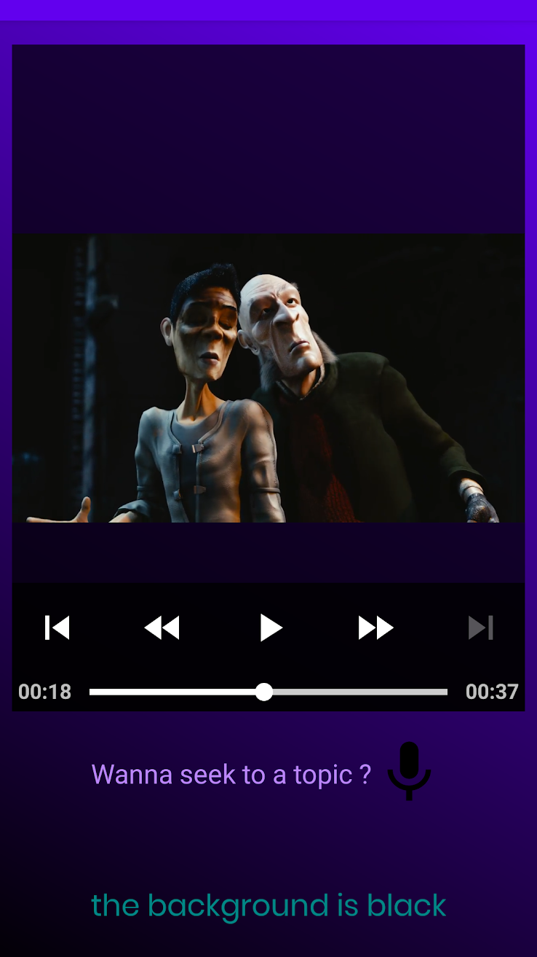
Keyword
Video seek automatically
Search by voice
Choose one time
Notes:
You can then use your voice to skip to that phrase in the video.

Slide 16
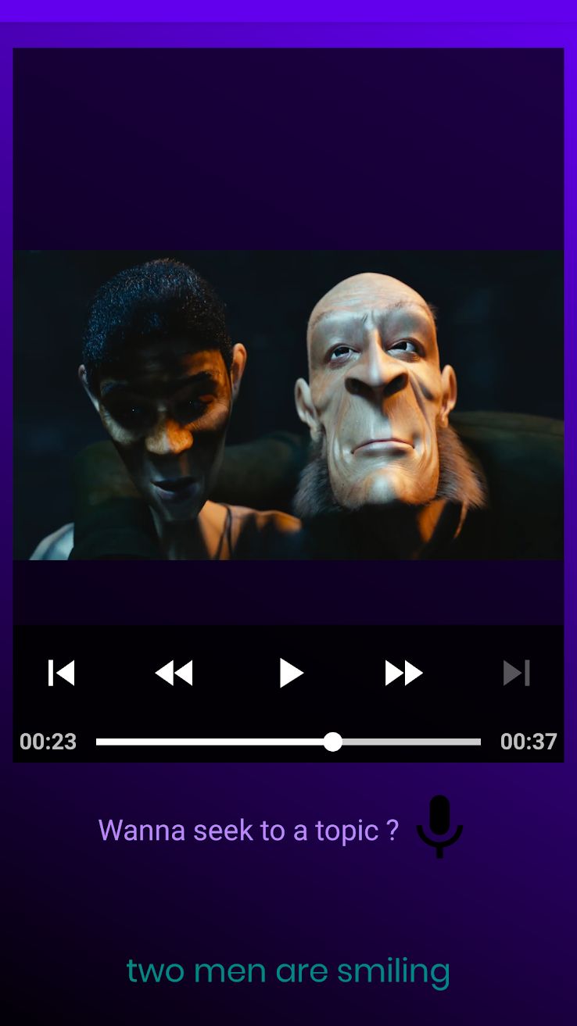
Scene Describer
Scene detection
Recognises when scenes change and outputs to audio output, a concise description of the frame
Notes:
The detector checks where the scene changes and triggers the describer. The describer -- in turn -- generates a description for the scene.
I must warn you, DenseCap model was trained on the Flickr8k dataset, which gives it a strange affinity to dogs!

Slide 17
WHAT IS IT?
Notes:
Sammy, in its skeleton, is a video player.

Slide 18
OCR
WHAT IS IT?
Optical Character Recognition
(Using Tesseract-OCR)
Notes:
It’s made up of three modules.. The first of which is OCR - Optical Character Recognition.
The recognition of on-screen text.
We’ll be using the Tesseract-OCR CLI tool to do OCR in this demo.

Slide 19
OCR
ASR
WHAT IS IT?
Optical Character Recognition
(Using Tesseract-OCR)
Automatic Speech Recognition (Using DeepSpeech)
Notes:
The second module is the ASR - Automatic Speech Recognition.
The ASR module transcribes texts and creates an index of terms used in the video.

Slide 20
OCR
ASR
WHAT IS IT?
SDD
Optical Character Recognition
(Using Tesseract-OCR)
Automatic Speech Recognition (Using DeepSpeech)
Scene Detection and Description
(Using FFmpeg and DenseCap)
Notes:
The final component is the SDD module. Created for scene detection and description.
For this demo, we used a FFmpeg filter for detection and the DenseCap Web API for description.

Slide 21
OCR
ASR
WHAT IS IT?
SDD
SAMMY
Optical Character Recognition
(Using Tesseract-OCR)
Automatic Speech Recognition (Using DeepSpeech)
Scene Detection and Description
(Using FFmpeg and DenseCap)
The video player that can tell you everything there is to know inside the video
Notes:
All of these put together create Sammy - the video player that can tell you all there is to know about a video.

Slide 22
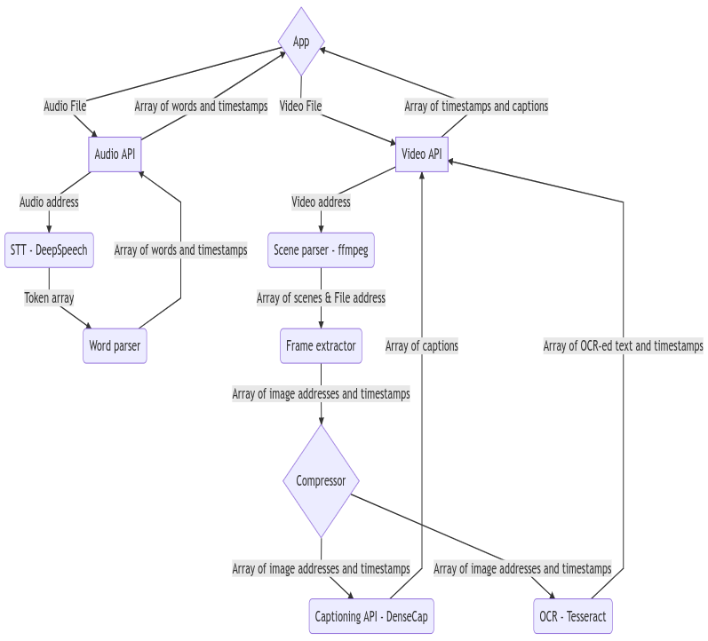

Slide 23

THANKS!
Questions?
Notes:
Thank you, no, we are not sales interns at SUBARU or anything like that.

